Slide 1
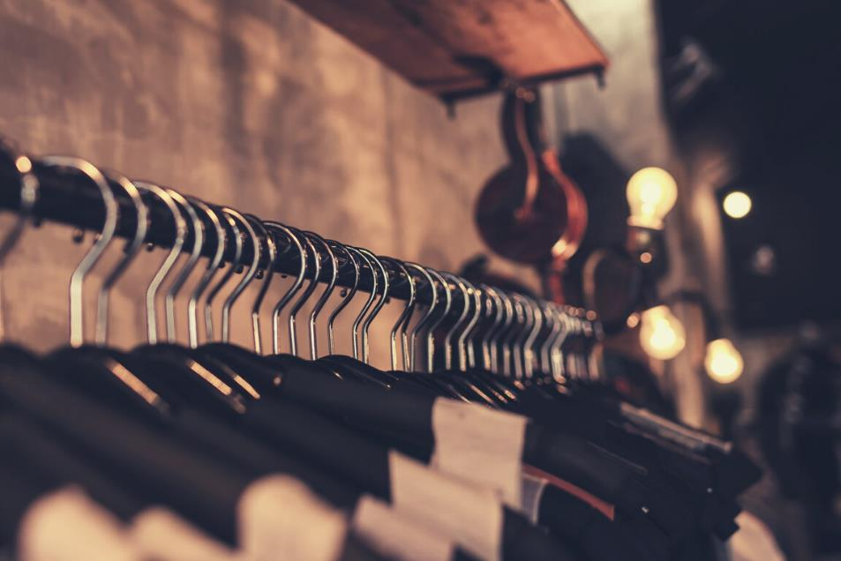
H.R.M. SOURCING LTD.
A Reliable Supplier to Retailers & Wholesalers Across the Globe
AN INTRODUCTION

Slide 2
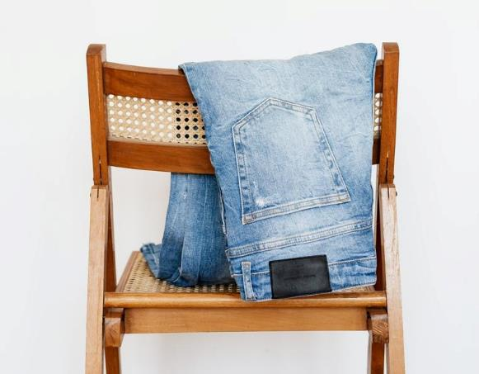
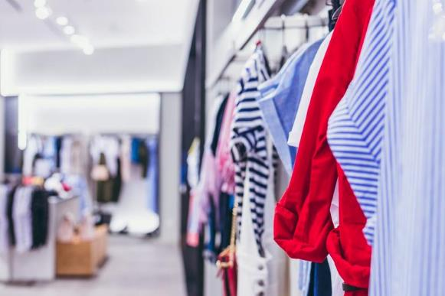
TABLE OF CONTENTS
TOPICS FOR DISCUSSION
Who are we?
Our leadership
Meet the team
Flagship products
Our clients
Our philosophy & process
How we evolve our strategy
Role of fashion sourcing
Creating value for clients
What our clients say
The path ahead
Contact us

Slide 3

WHO ARE WE?
We are more than a sourcing agency. Our clients recognize us as a buying house with multiple supply chains in the global garments industry. Based in Bangladesh, with multiple regional offices, including in Germany, Poland, Italy and France, we have a loyal clientele across North America, Europe, and other parts of the world.
Over the last 15 years, we have built the reputation of a dependable garments sourcing company with high-quality products delivered in timely shipments.

Slide 4
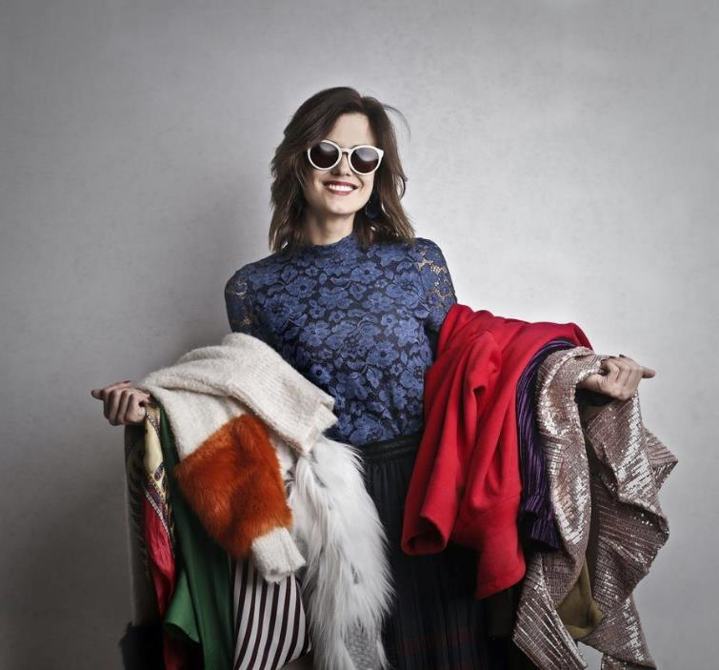
WHO ARE WE?
We are a significant player in the fast growing garments industry in Bangladesh. Our supply chains provide an end-to-end solution for manufacturing and delivering preset and custom-fit orders of all volumes. Our key garments products are:
  Flat Knit
  Circular Knit
  Woven Wear
Our clients include global apparel retailers and wholesalers.

Slide 5
2006
320,000
USD 1.47M
15
TURNOVER IN PIECES
TURNOVER IN CURRENCY
NUMBER OF EMPLOYEES
GROWTH IN A DECADE
12 M
USD 49 M
85
2016

Slide 6
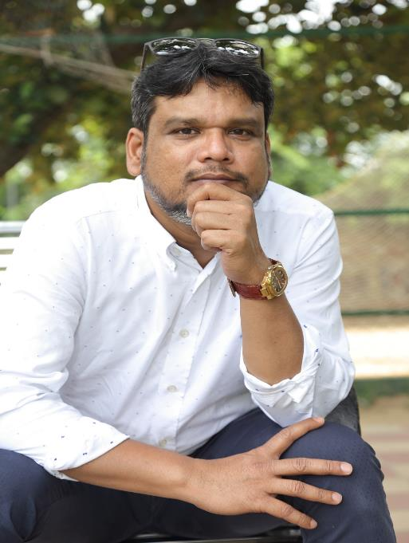
RIPON FAKRUL KABIR
MANAGING DIRECTOR
CELL: +88 0181 921 5678
MAIL: ripon.fakrul@hrmsourcing.net
SKYPE: ripon.fakrul1

Slide 7
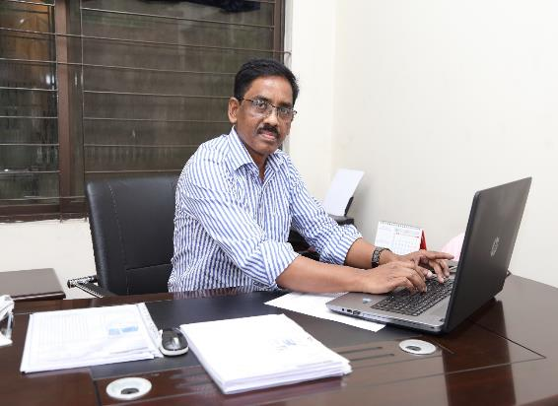
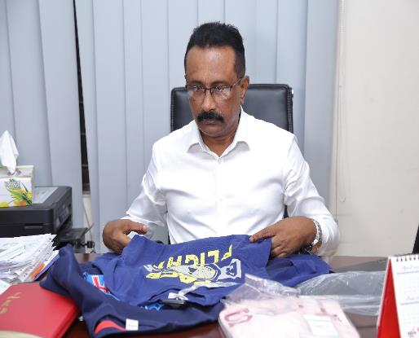
MEET THE TEAM
DYNAMIC AND DRIVEN
MD. MAHMUDUR RAHMAN EXECUTIVE DIRECTOR
MD. EZAZ HOSSAIN
GENERAL MANAGER
Head of merchandising & communications with clients –manages shipments from development to finish
Technical & quality troubleshooting to ensure products are developed in correct form and fit

Slide 8

EXPERT QUALITY CONTROL
CERTIFIED PROCESSES
HRM Sourcing Ltd. leadership firmly believes in using the best talent for every role. Owing to their immense experience in managing garment supply chains, the Italian technical unit in our team is given the job to manage QC.
Every HRM Sourcing Ltd. factory is ISO certified for garments manufacturing. We fully comply with applicable regulations and manufacture garments in factories that are regularly inspected by independent agencies.
FOCUS ON QUALITY
DIVERSE CAPABILITIES
ALWAYS FASHIONABLE
Over time, HRM Sourcing Ltd. has expanded its portfolio to include circular knit, flat knit, woven, and denim products. These producs have formed HRM's signature lines and demonstrate our diverse capabilities.
Our product lines evolve with the fashion needs of our target markets, mainly Eastern and Southern Europe. Our designs always stay in fashion and make it easier for brands to order frequently and in bulk quantities.

Slide 9
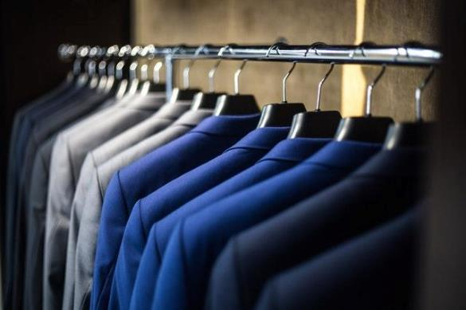
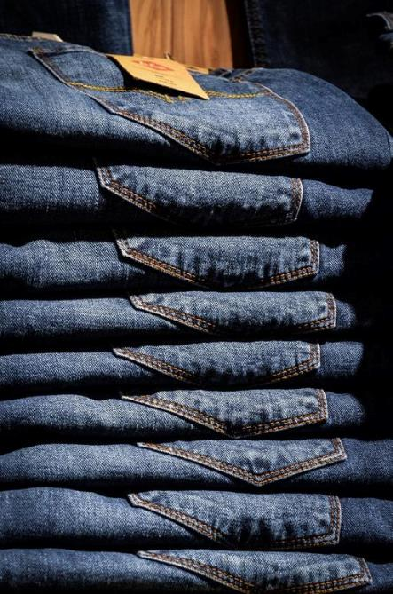
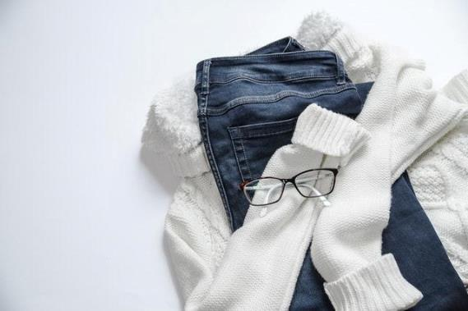
FLAGSHIP PRODUCTS
KNITWEAR
Flat knit, circular knit, and woven lines for men, women and children
DENIM
Best quality denim/jeans products for all key segments
FORMAL WEAR
Elegant and high-quality formal lines for men, women and children

Slide 10
FLAGSHIP PRODUCTS
Formal Wear
5%
Flat Knit
10%
DISTRIBUTION OF PRODUCT LINES
Woven
20%
Circular Knit products make for our most popular lines and comprise two-thirds of all our shipments.
Woven wear comes next and makes for 20% of our production on average every year.
Finally, Flat Knit and Formal Wear shipments are last, but not the least, of our high-quality product lines, and make for a total of 15% of our production each year on average.
Circular Knit
65%

Slide 11
WHOM DO WE SERVE?
North America
5%
Eastern Europe
20%
GEOGRAPHY OF OUR CLIENTELE
Over the past 15 years, HRM Sourcing Ltd. has developed relationships in various regions of the world, working with numerous apparel retail brands and wholesale businesses.
While we have active relationships in many parts of the world, as shown on the left, our key markets lie in Eastern and Southern Europe, which comprise over 90% of all our orders and exports.
Australia
5%
Southern Europe
70%

Slide 12



















OUR PRESTIGIOUS CLIENTS

Slide 13
OUR THRIVING PHILOSOPHY
"In business, the idea of measuring what you are doing, picking the measurements that count, like customer satisfaction and performance... you thrive on that."
- BILL GATES

Slide 14
OUR PROCESS
STEP 01
STEP 02
STEP 03
STEP 04
SAMPLING
LEGAL & INFORMATION
PRODUCTION
SHIPMENT
  Sampling query from client
  Prototype sample
  Sample approval
  Price negotiations
  Purchase order
  Proceed to L/C and proforma invoice
  L/C from client's bank to HRM's bank
  Correspondence for product details
  Material requisition
  Pre-production sampling
  Production initiated
  Frequent feedback recorded over shipments
  Finished goods sample sent to client
  Product sent for shipment
  Export documentation cross-checked
  Transfer of goods and payment
  Client feedback is sought

Slide 15
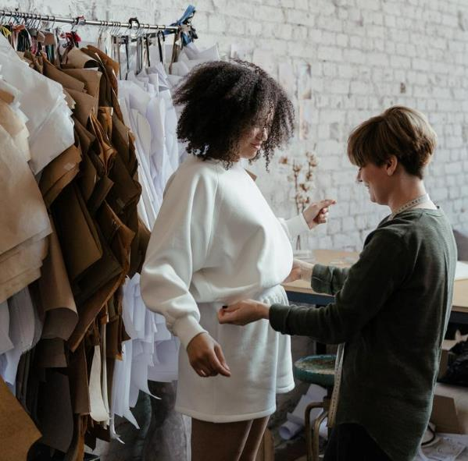
HOW OUR PRODUCT STRATEGY EVOLVES
FASHION TRENDS
Constant market research helps us identify successful design ideas
CLIENT FEEDBACK
Analyzing collected client feedback about customer demands helps
EXPERT OPINIONS
Talking to fashion experts frequently keeps us ready for the future

Slide 16

THE ROLE OF FASHION SOURCING
EMPOWERING THE GARMENTS INDUSTRY
Fashion sourcing makes it easy for businesses in the fashion industry, including wholesalers and retail brands, to showcase and sell good-quality ready-to-wear products by importing them from a bulk producer, which cuts down production costs significantly and eliminates the need for running a manufacturing operation with local labor and endless operational headaches and costs.

Slide 17

CREATING UNBEATABLE VALUE FOR OUR CLIENTS
HRM Sourcing Ltd. has unified the segmented services in fashion sourcing and created end-to-end solutions, which allows our clients to hand over the entire design, production and shipment process to us. All they have to do is tell us their needs, give us feedback on the samples, have their legal team look over the necessary paperwork, and pay for the job. We do the rest.

Slide 18
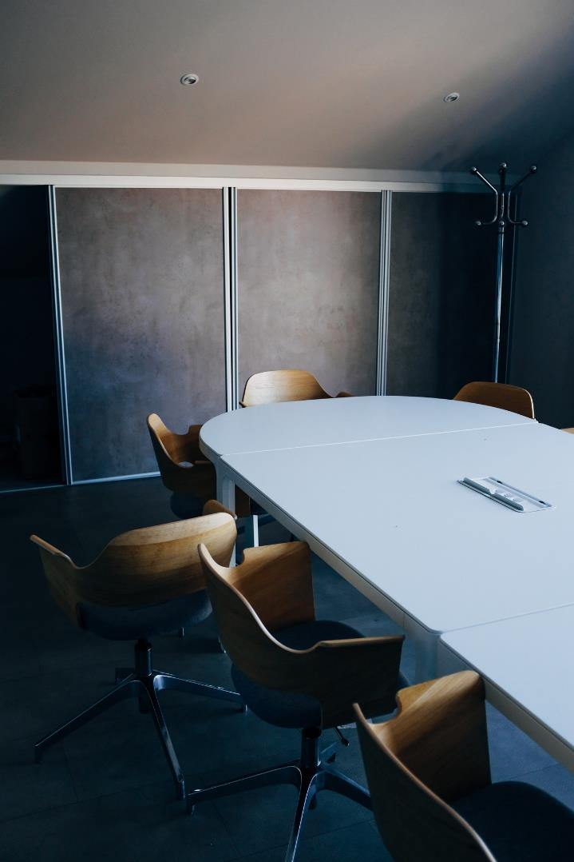
WHAT OUR CLIENTS SAY
ANTONIO BERNARDO
President – Piazza Italia Spa
“HRM truly stands for quality and commitment.”
FRANCESCO BERNARDO
ROCCO SPENA
CEO – Piazza Italia Spa
President – Essemoda SRL
“HRM delivers excellent performance with on-time error-free shipments.”
“HRM will always be my first choice for quality and on-time shipments.”

Slide 19
The
HRM
Experience
A sneak peek at HRM and its associated garments factories: This video shows how we operate, how our workers are treated, and how we are working as a single team led by professionals seeking to build the most favorable conditions for HRM workers and best quality products for HRM customers.

Slide 20



WHAT LIES AHEAD: KEY BUSINESS TARGETS
NEW CONTRACTS
FOCUS ON ECO-FRIENDLY PRODUCTION
RACE TO THE FIRST 100M
To acquire new contracts with globally renowned fashion retail brands, such as Zara, Pull&Bear, H&M, and Tesco, and expand our portfolio further
To be more environmentally responsible in our methods and processes by using more organic materials, such as organic cotton and recycled bamboo, etc.
To archive our first annual 100M turnover for the fiscal year 2022-2023

Slide 21
HEADQUARTERS
TALK TO US!
House No # 1220, Avenue # 11,
Mirpur DOHS, Dhaka-1216.
PHONE NUMBER
CONTACT INFORMATION
+88 0963 888 1100 , +88 0963 888 2200, +88 0197 921 5693
EMAIL ADDRESS
info@hrmsourcing.net

Slide 22
REGION 1 OFFICE
REGION 2 OFFICE
Stuttgart, Germany
Sosnowiec, Poland
HRM Textil GMBH
Ulmer Strabe 184
70188 Stuttgart, Germany
F.W Ganges SP.J
Ul,Partyzantow 3,5,7
41-200 Sosnowiec, Poland
Phone
Phone
0711 6451 5575
32 266 8484

